Slide 1

Infosys springboard 5.0
E-Learning system
-Mentor :Sanjeeva Gone
Team 2:
1. Varsini M
2. Yashwanth Anumandla
3. Alkab Rza
4. Ritik Kumar Sahoo

Slide 2

introduction
Purpose: The E-Learning System aims to provide a flexible and accessible platform for education, allowing users to learn at their own pace and convenience from remote locations.
Significance: This platform is designed to meet the needs of students, professionals, and job seekers, enabling them to acquire new skills or qualifications without disrupting their daily responsibilities.
System Features: The E-Learning System provides secure user authentication with OTP verification, a user-friendly course management interface, automated email notifications for enrollments and password recovery, detailed course schedules with downloadable resources, and integrated feedback collection for continuous improvement.

Slide 3


Objective
User-friendly interface with search and feedback options.
Secure login and OTP-based registration.
Course enrollment with detailed modules.
Email notifications for enrollments and updates.
Admin panel for course management.

Slide 4
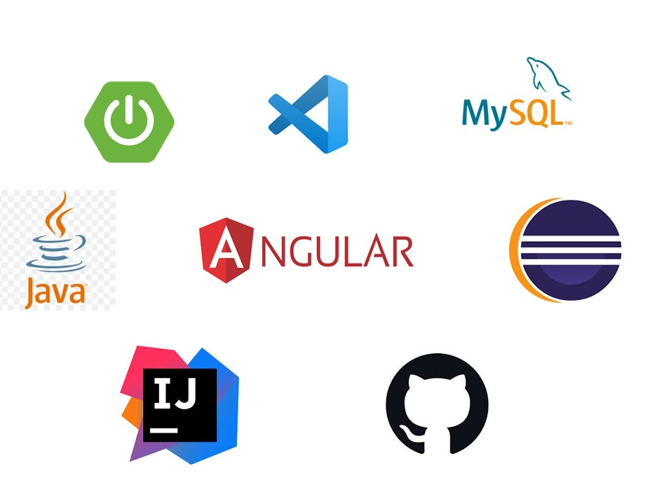
methodology
Requirement Analysis
System Design
Module-Wise Development
Database Design
Testing and Validation
Integration and Deployment
Feedback and Iteration
Frontend: Angular
Backend: Java and Spring Boot
Database: MySQL
IDE: VS Code and Eclipse
Version Control: GitHub

Slide 5
modules
1
User Authentication and OTP based Registration
Secure user authentication and registration process to manage user accounts.
2
Forgot Password Secure login
Email-based password recovery system for seamless account access.
3
Course Display and Search
User-friendly interface for browsing and searching available courses.
4
Course Enroll Management
Automated enrollment process with email notifications for registered courses.
5
Feedback System
Simple feedback submission to collect user opinions for improvements.
Course Details and Resources
6
Detailed course pages with schedules, downloadable resources, and quizzes.
7
Admin Dashboard
A comprehensive dashboard for administrators to manage and update courses.

Slide 6





Project milestone
E-Learning System
1
Implemented a secure system for user login, OTP-based registration, and account recovery.
2
Designed a user-friendly interface to browse, search, and enroll in courses seamlessly.
3
Built a feedback system for users to share their opinions and suggestions.
4
Integrated automated email notifications for course enrollment and password recovery.
5
Delivered a fully functional e-learning platform with course details, downloadable resources, and admin management features.

Slide 7


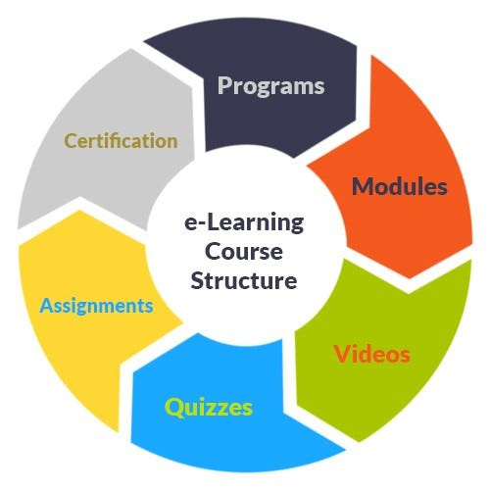
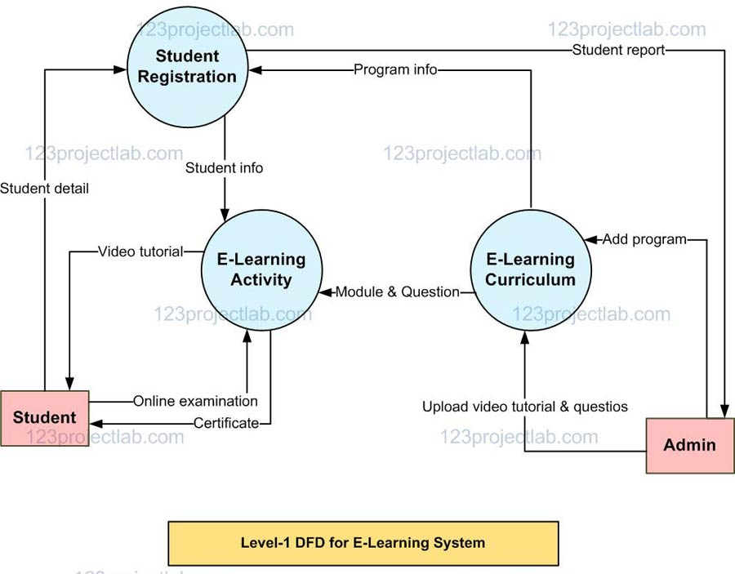


Data Flow application

Slide 8



Challenges and solution
Challenges:
Data Privacy Concerns: Safeguarding user credentials and personal information against cyber threats.
System Scalability: Managing high user traffic and ensuring smooth application performance.
Seamless Integration: Ensuring proper synchronization between frontend and backend modules..
Solutions:
Enhanced Security Measures: Implemented encryption, authentication mechanisms, and secure APIs.
Performance Optimization: Leveraged caching techniques and optimized database queries for scalability.
Key Takeaway:
The project demonstrates the importance of integrating robust security, seamless communication between components, and scalability features to ensure user satisfaction and system reliability.

Slide 9
results
User Authentication: Implemented a secure login and registration process with OTP verification for user account creation.
Course Enrollment: Enabled easy course selection and enrollment with automated confirmation emails for the registered courses.
Feedback Management: Developed a feedback collection system to capture user opinions for continuous platform improvement.
Mail Notification: Integrated an automated email notification system for course enrollment updates and password recovery instructions.
Improved Accessibility: Enabled smooth course browsing, enrollment, and access through an intuitive user interface.

Slide 10


Testing and validations
Unit Testing: Each component of the platform will be rigorously tested to ensure it functions correctly.
Integration Testing: The platform's different components will be tested together to ensure seamless integration.
User Acceptance Testing: The platform will be tested by real users to get feedback on its usability and effectiveness.

Slide 11


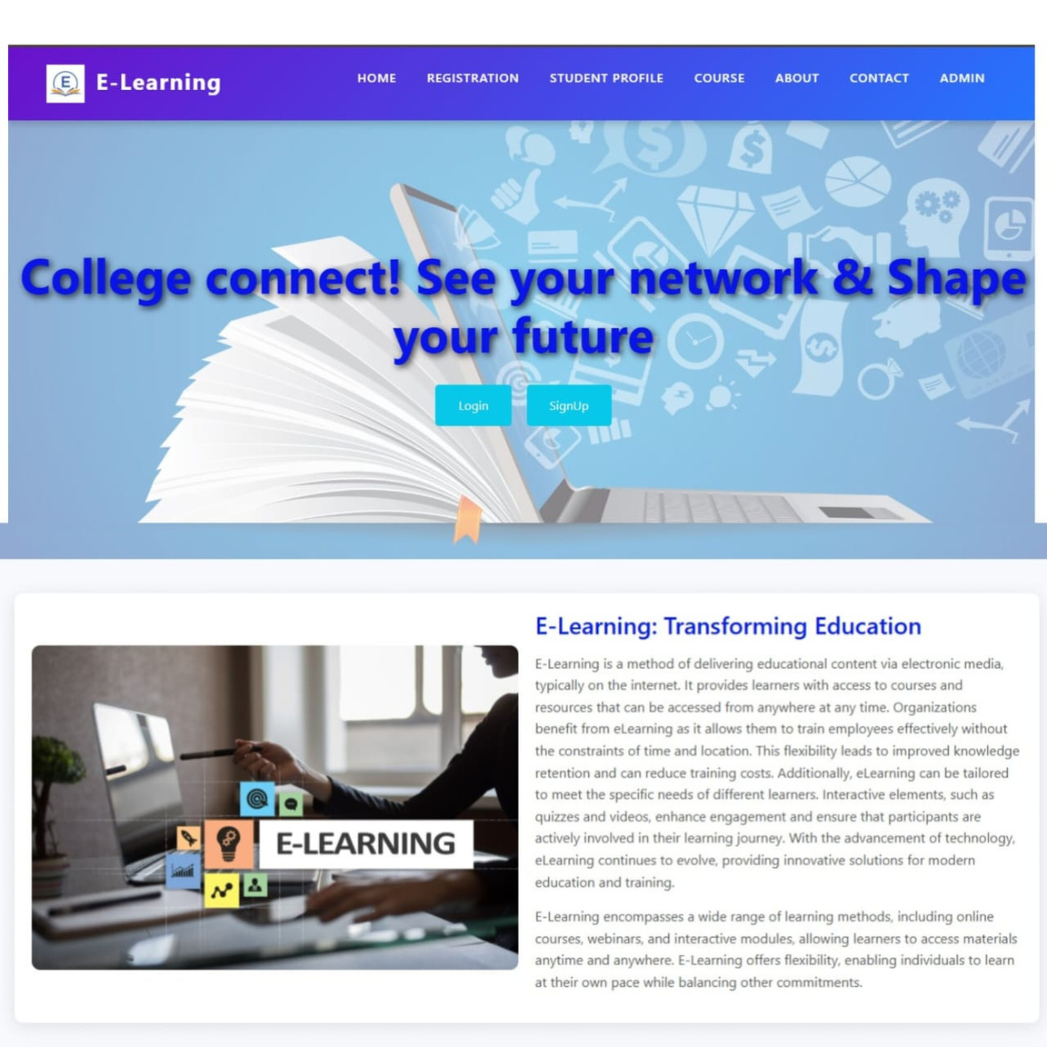
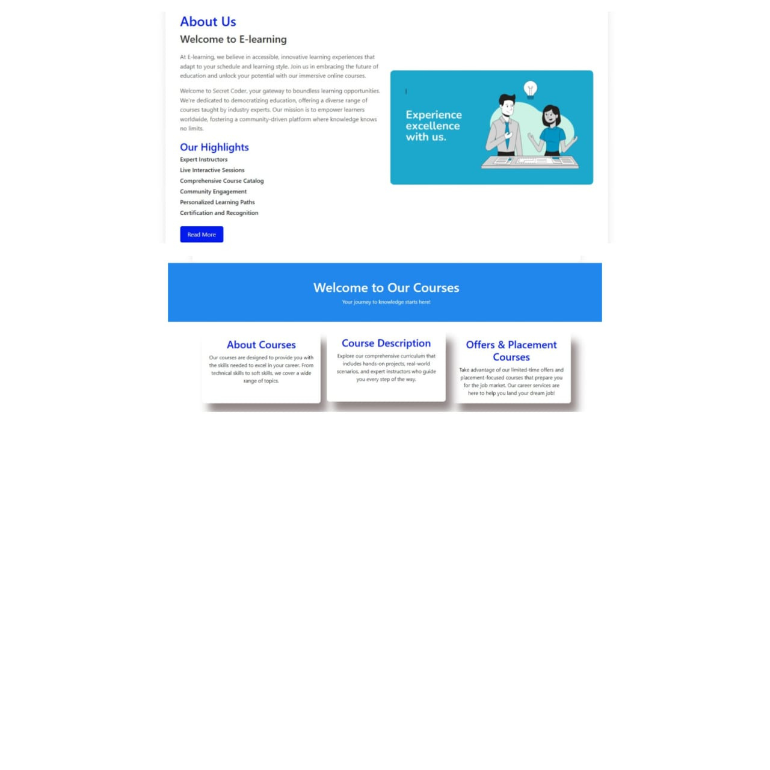
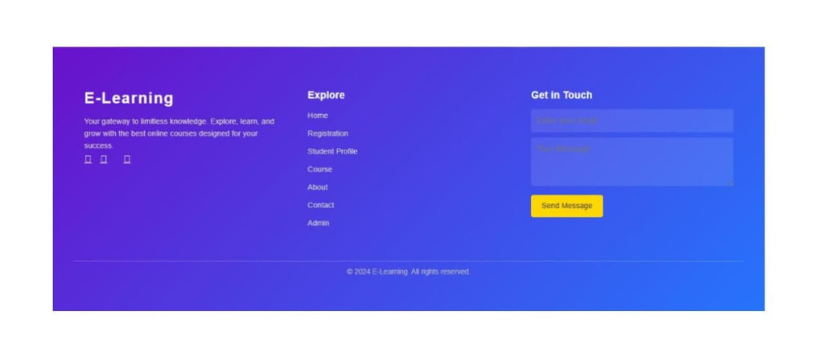

Output
Home page

Slide 12
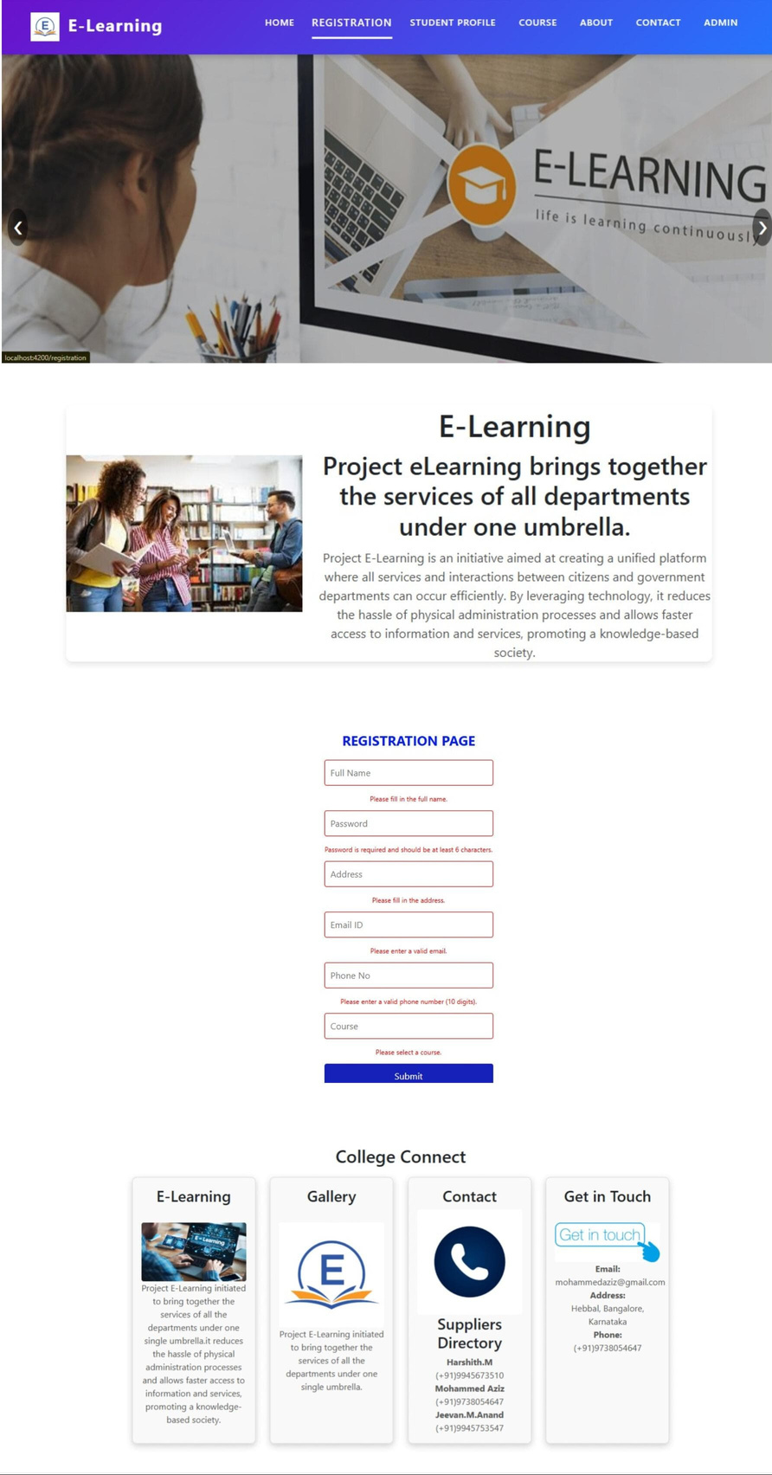
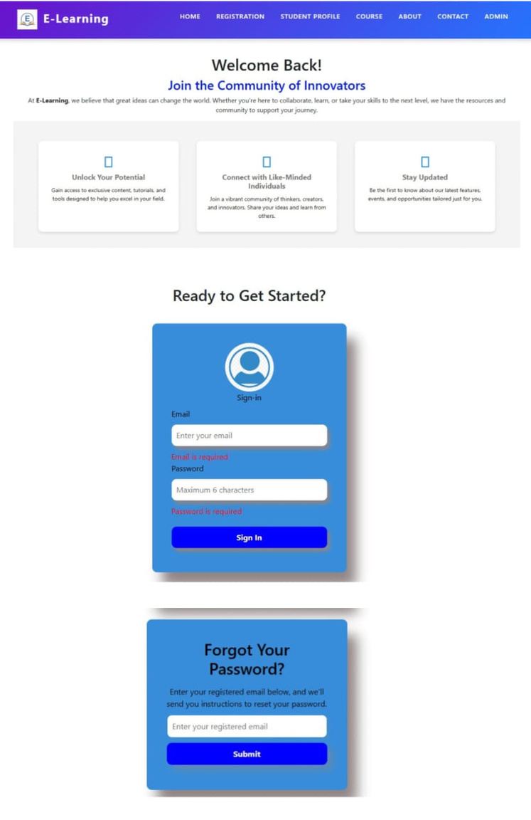
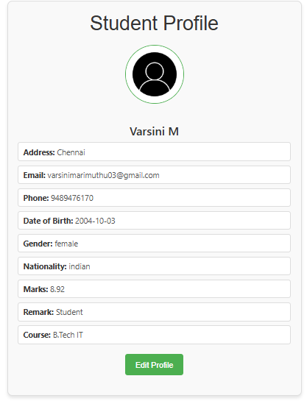

Registration , Login page & user profile

Slide 13
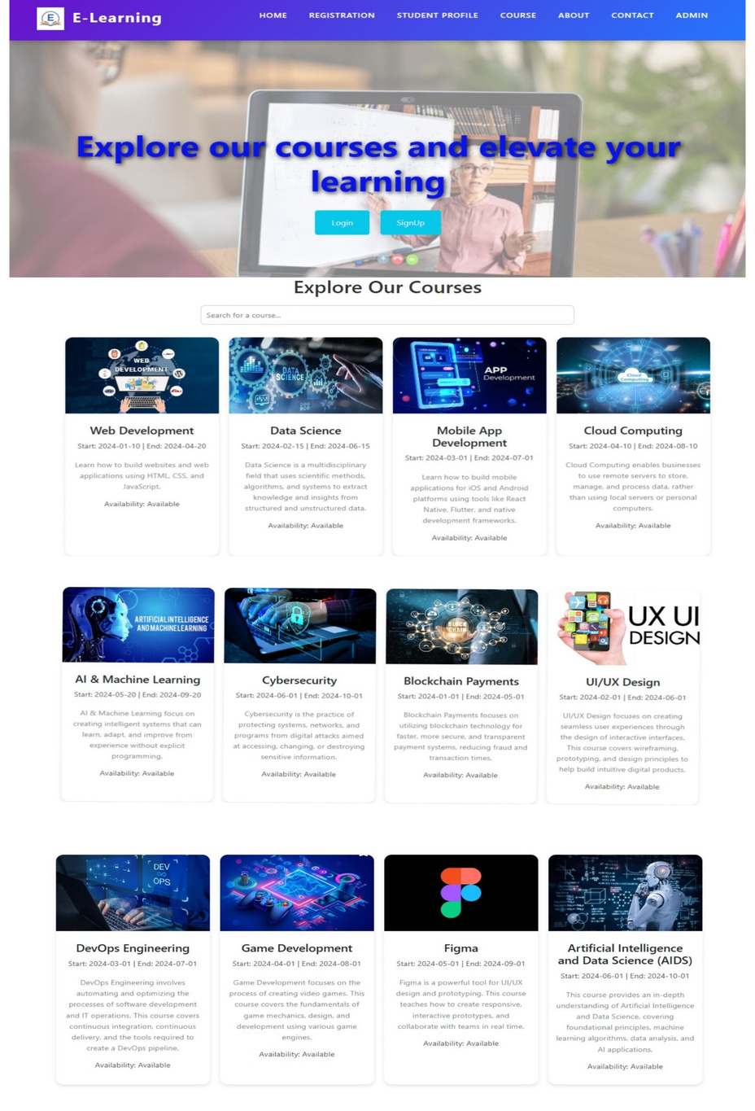
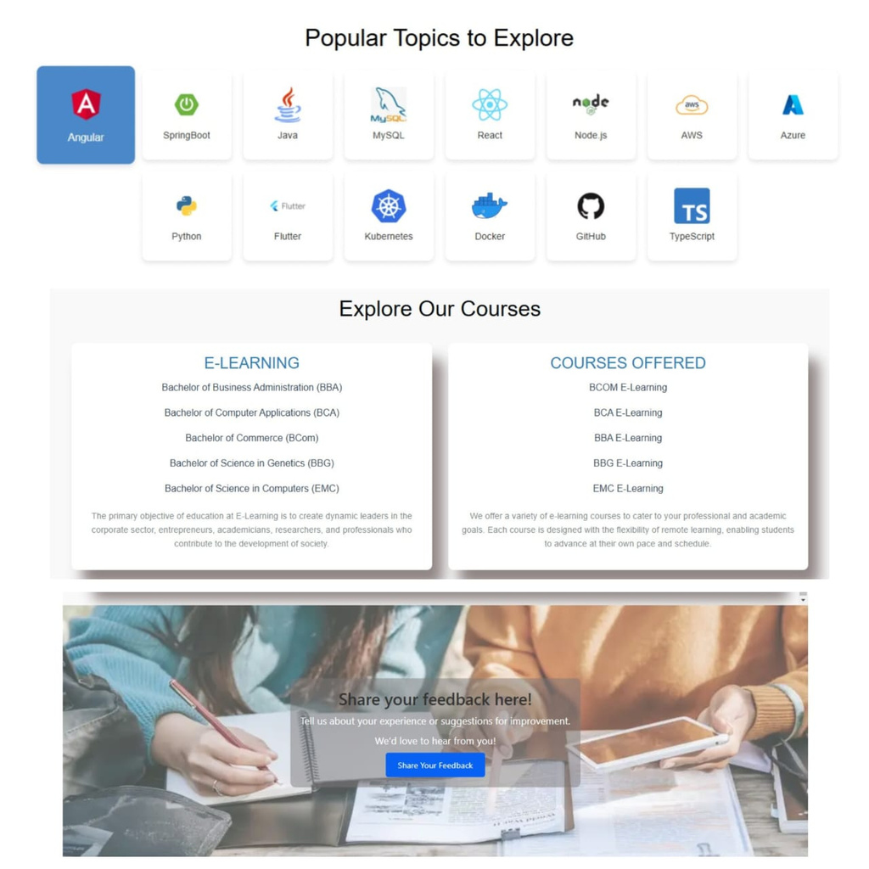
Course page

Slide 14
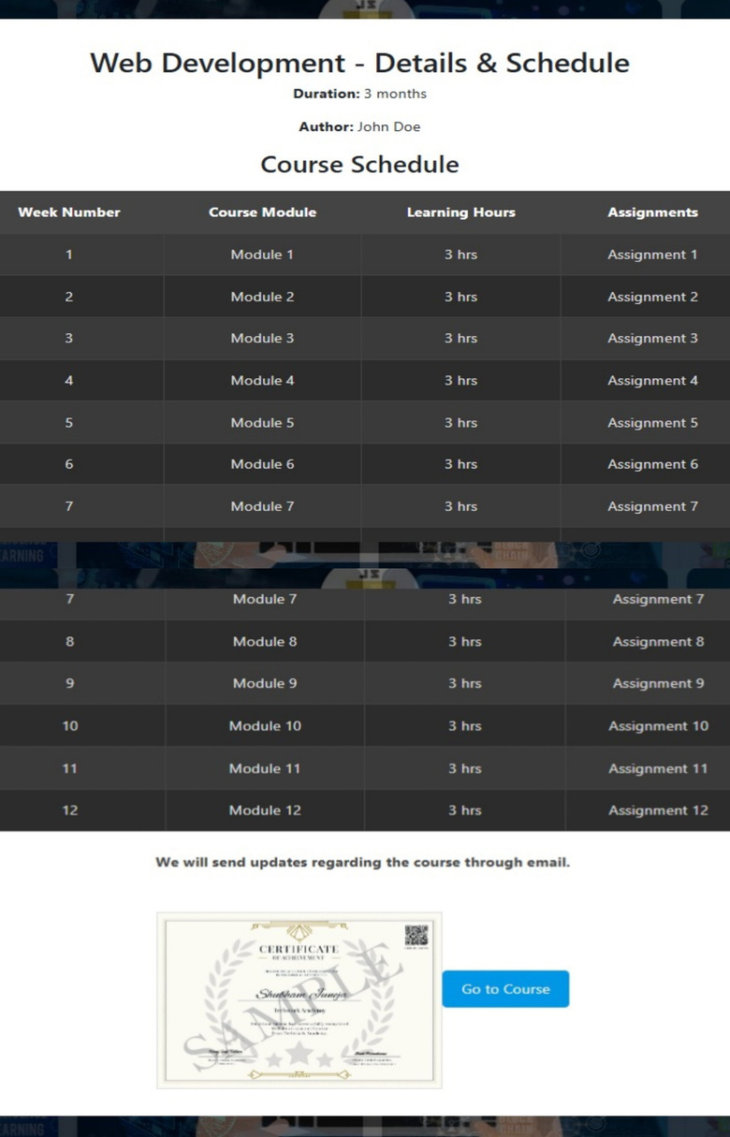
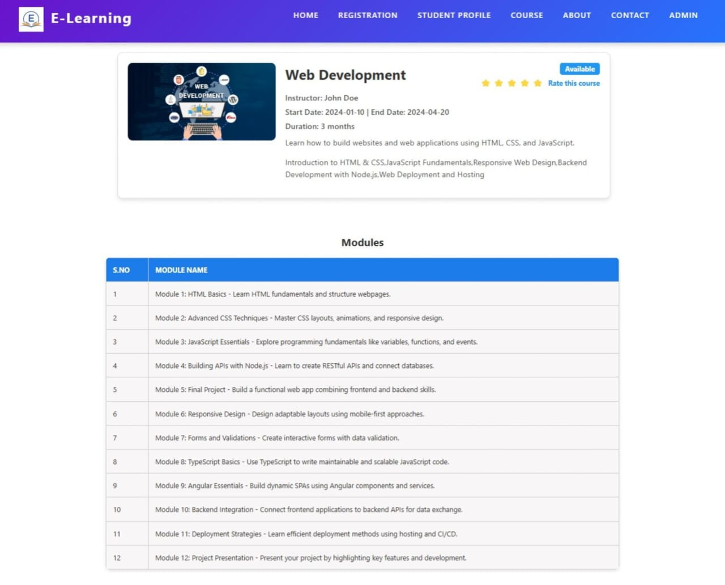
Course page

Slide 15
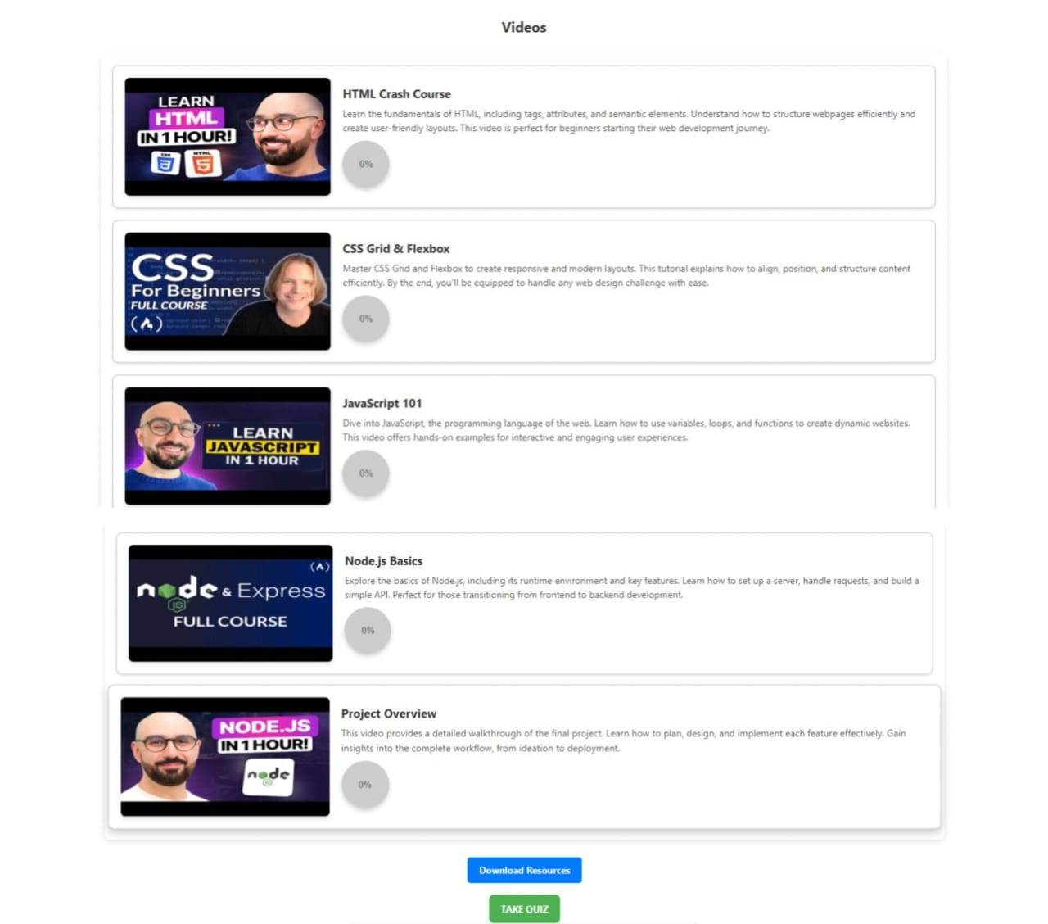
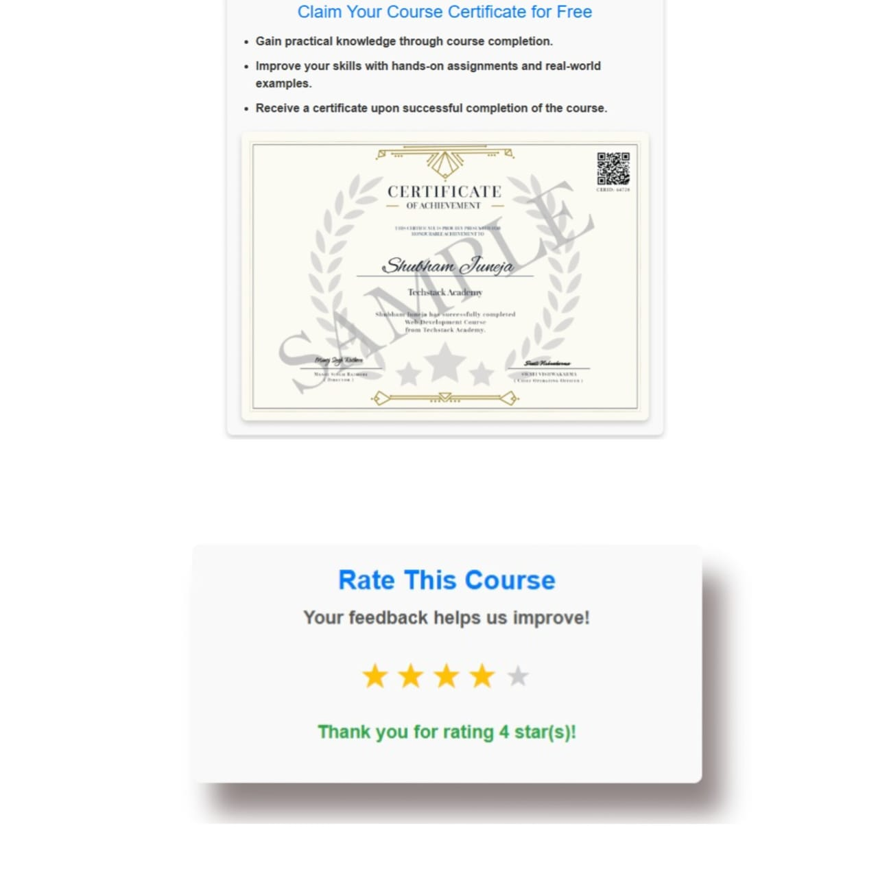
Course page

Slide 16
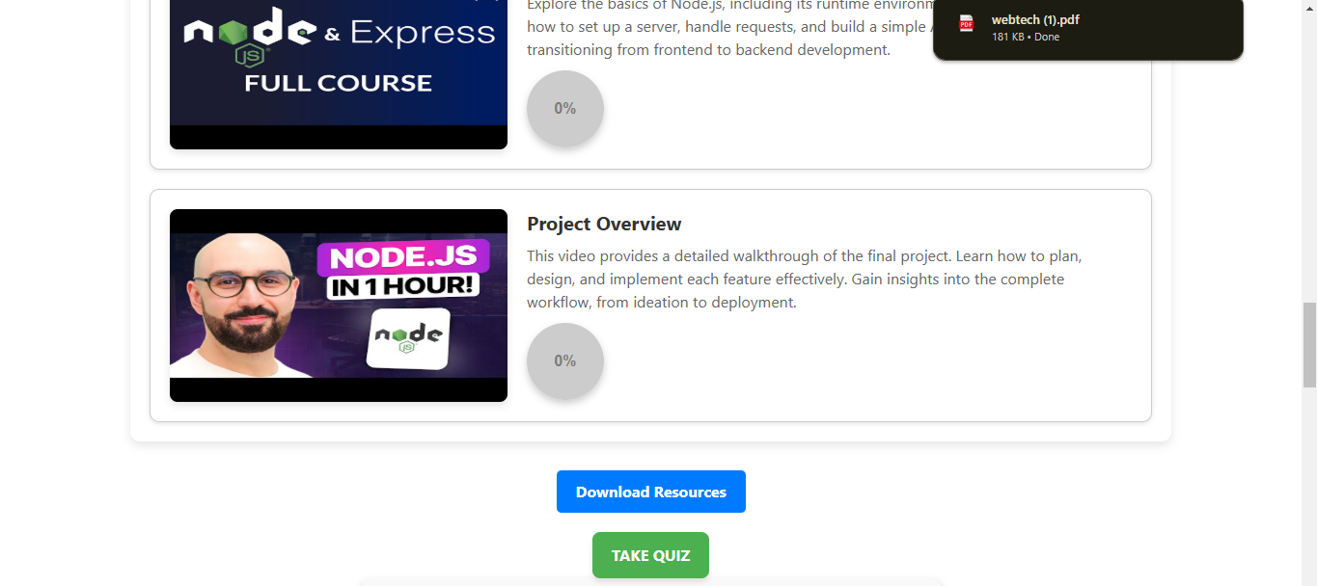
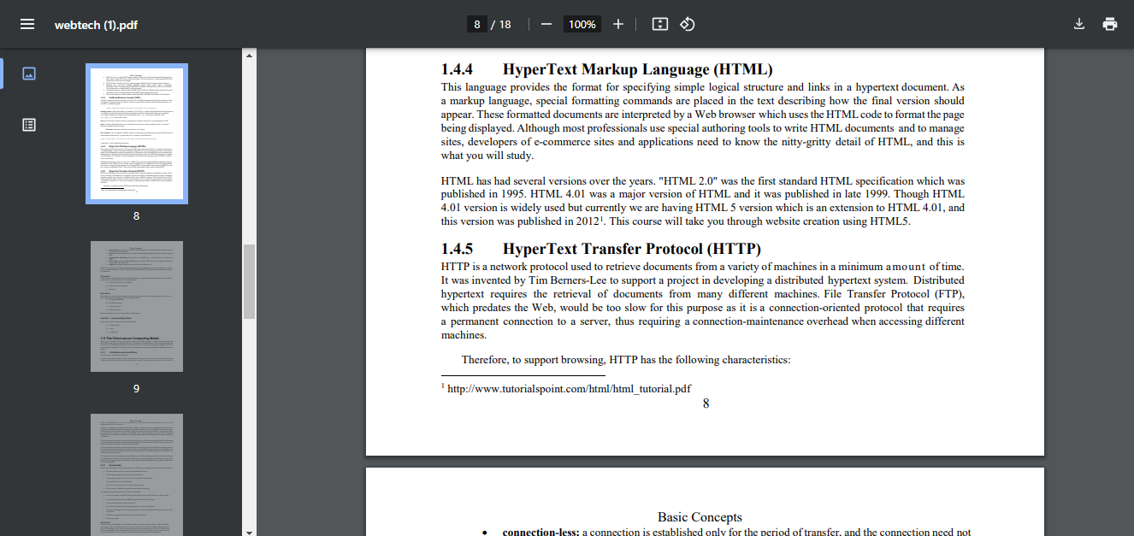
Course page

Slide 17
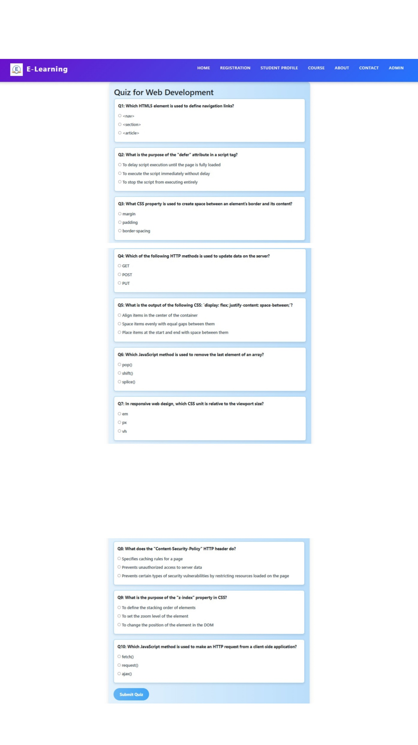
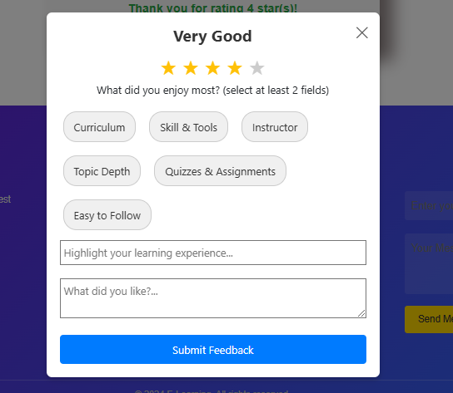
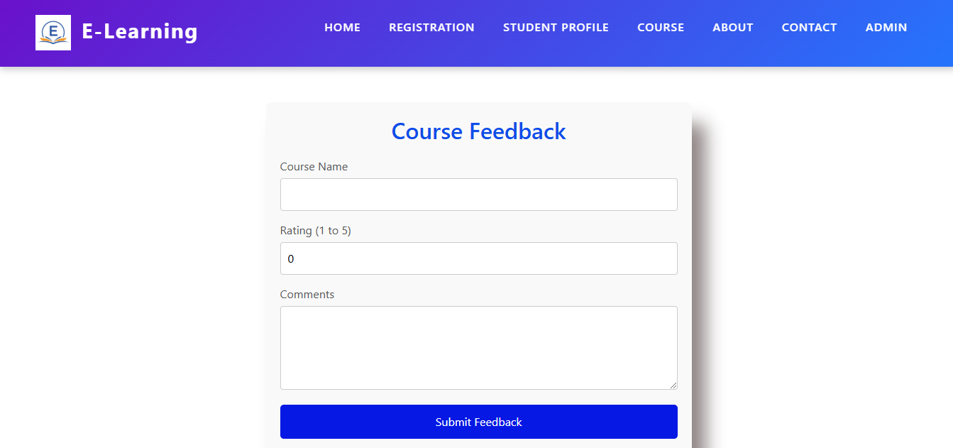
Quiz and feedback

Slide 18
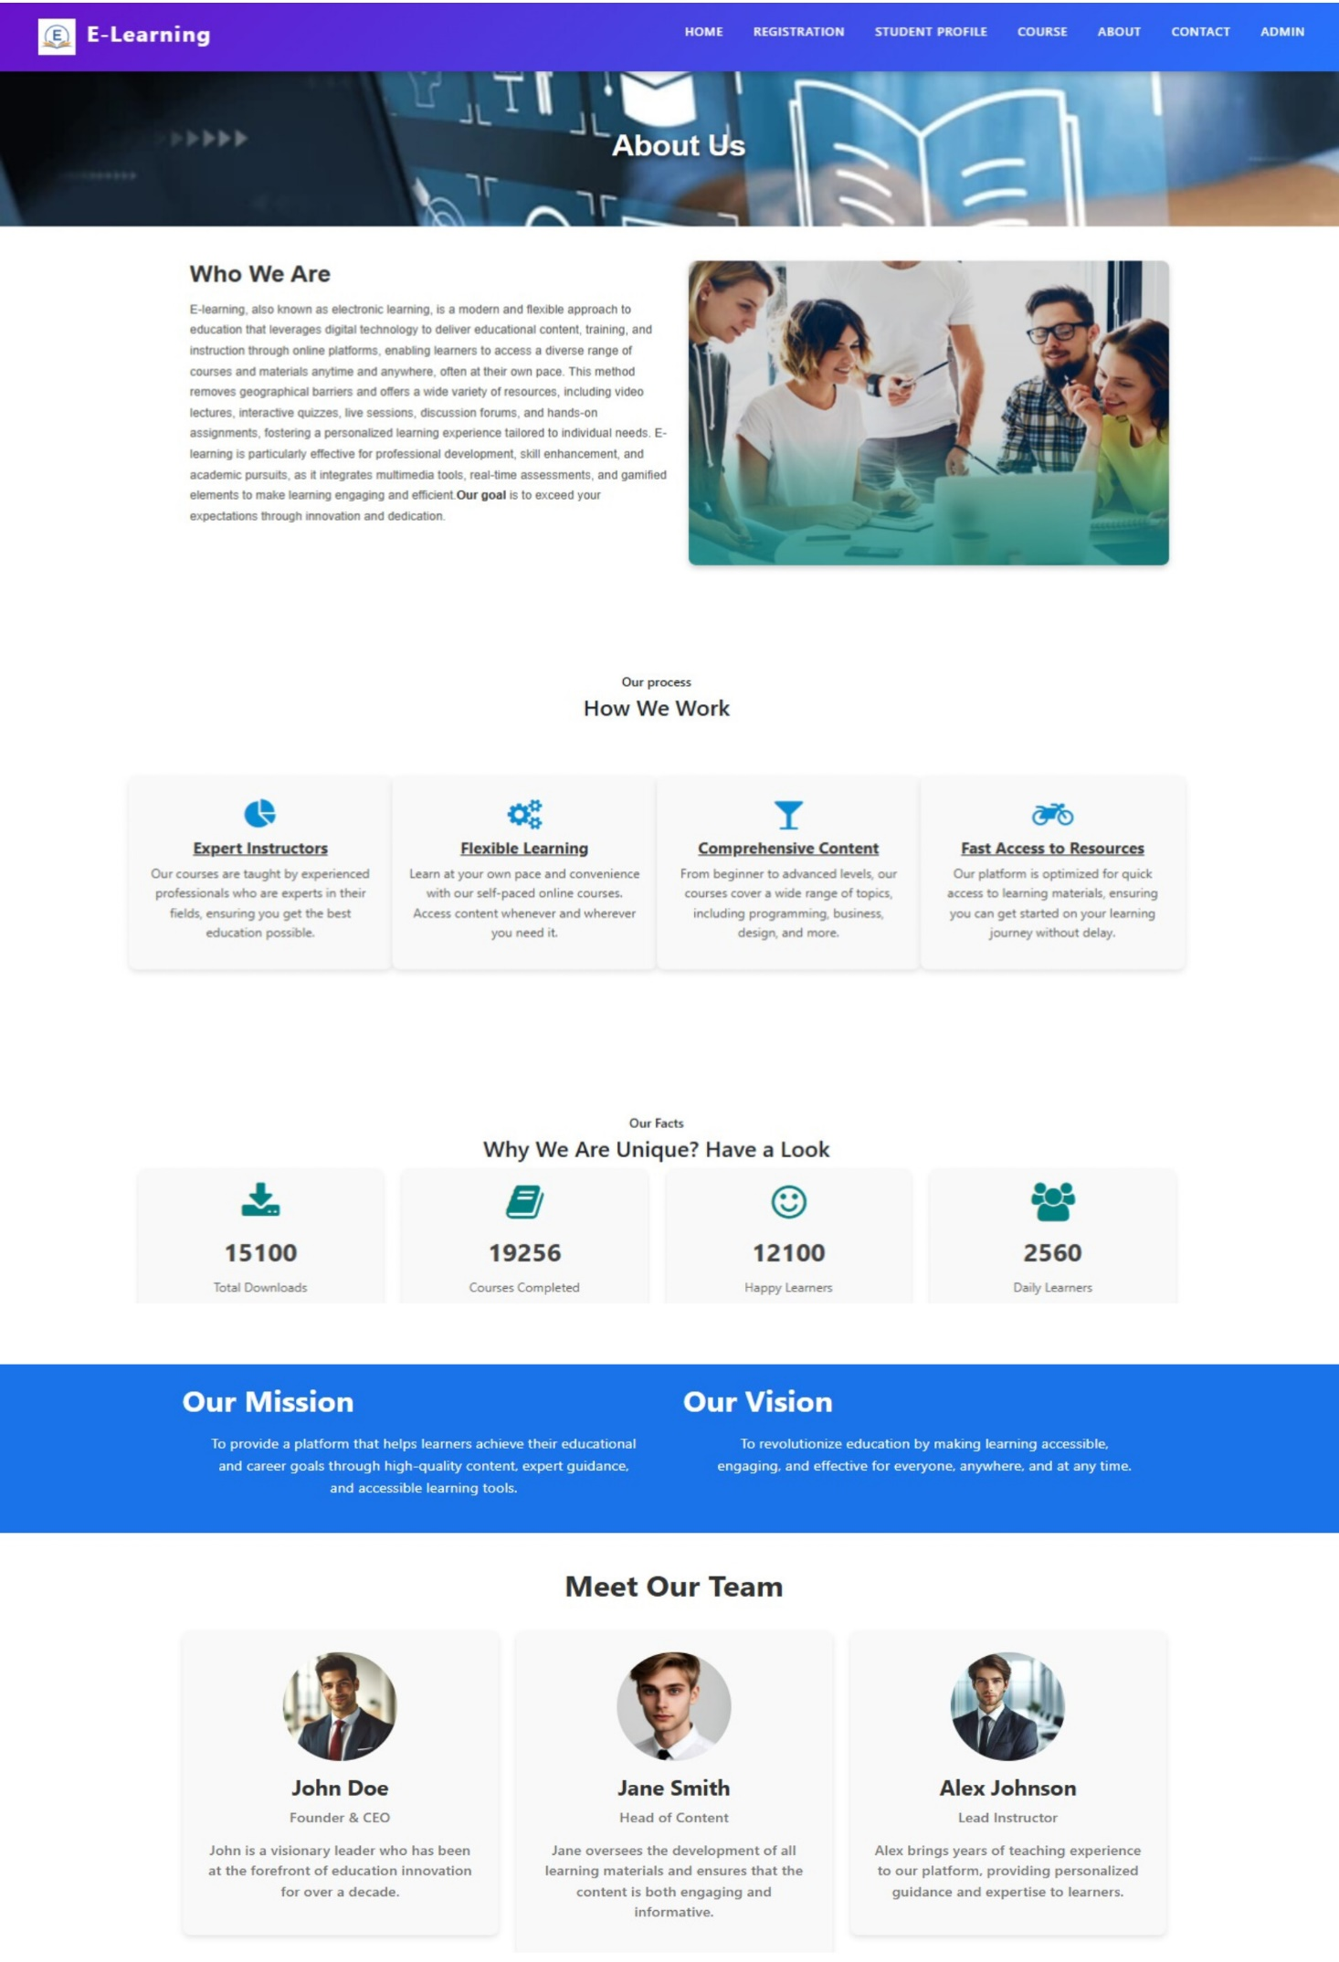
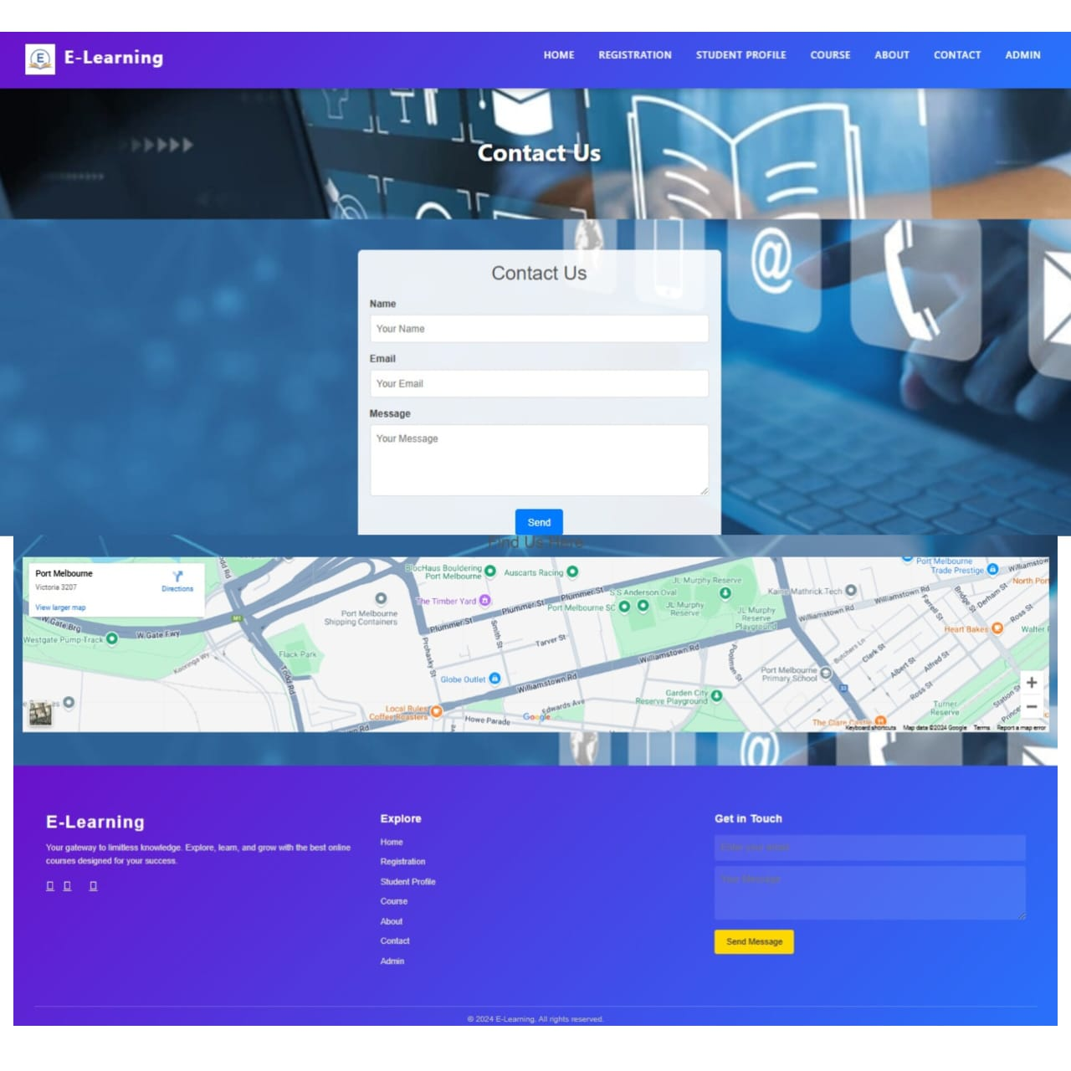
About and contact page

Slide 19
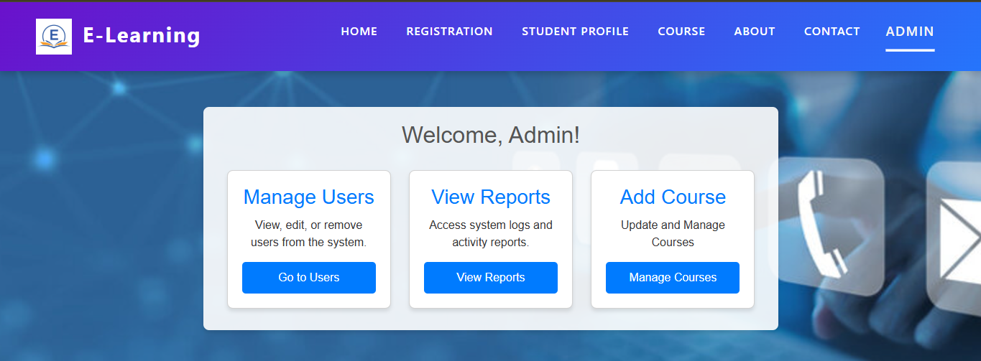
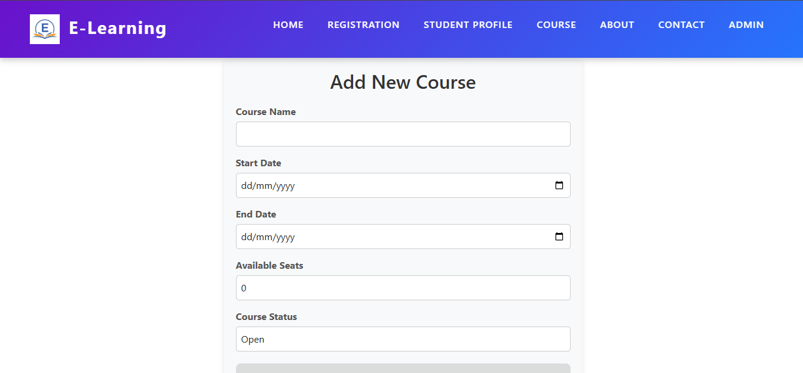
ADMIN PAGE

Slide 20



acknowledgement
We express our heartfelt gratitude to our mentor, Sanjeeva Gone, for his invaluable guidance, support, and encouragement throughout the development of this project. His expertise and constructive feedback were instrumental in shaping the E-Learning System. We also extend our thanks to our institution for providing the necessary resources and a conducive environment to carry out this work. Finally, we appreciate the teamwork and collaboration that contributed to the successful completion of this project.

Slide 21
CONCLUSION
The E-Learning System was successfully designed and implemented to provide a secure, user-friendly, and efficient platform for online education. By incorporating key features such as user authentication, course enrollment, feedback management, and automated notifications, the system ensures an enhanced learning experience for students, educators, and professionals. Future enhancements could include personalized learning recommendations, multilingual support, and advanced analytics to further enrich the platform and cater to diverse learning needs.

Slide 22

Thank you

